Slide 1
SEQUENTIAL COUNTER with UNUSED STATE
EXAMPLE 1
LECTURE 12

Slide 2
STATE DIAGRAM
00
UNUSED
STATE
01
10
11

Slide 3
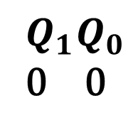
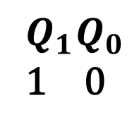
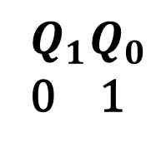
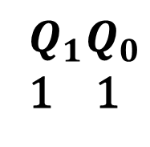
STATE DIAGRAM
UNUSED
STATE

Slide 4
NEXT STATE TABLE
PRESENT STATE |  | NEXT STATE
0 | 0 | 0 | 1
0 | 1 | 1 | 1
1 | 1 | 0 | 0

Slide 5
NEXT STATE TABLE USING JK FLIP FLOP
 |  | J | K
0 | 0 | 0 | X
0 | 1 | 1 | X
1 | 0 | X | 1
1 | 1 | X | 0

Slide 6
NEXT STATE TABLE
 |  | J | K
0 | 0 | 0 | X
0 | 1 | 1 | X
1 | 0 | X | 1
1 | 1 | X | 0
PRESENT STATE |  | NEXT STATE |  | JK FLIP FLOP INPUTS
0 | 0 | 0 | 1 | 0 | X
0 | 1 | 1 | 1
1 | 1 | 0 | 0

Slide 7
NEXT STATE TABLE
 |  | J | K
0 | 0 | 0 | X
0 | 1 | 1 | X
1 | 0 | X | 1
1 | 1 | X | 0
PRESENT STATE |  | NEXT STATE |  | JK FLIP FLOP INPUTS
0 | 0 | 0 | 1 | 0 | X
0 | 1 | 1 | 1
1 | 1 | 0 | 0

Slide 8
NEXT STATE TABLE
 |  | J | K
0 | 0 | 0 | X
0 | 1 | 1 | X
1 | 0 | X | 1
1 | 1 | X | 0
PRESENT STATE |  | NEXT STATE |  | JK FLIP FLOP INPUTS
0 | 0 | 0 | 1 | 0 | X | 1 | X
0 | 1 | 1 | 1 | 1 | X
1 | 1 | 0 | 0

Slide 9
NEXT STATE TABLE
 |  | J | K
0 | 0 | 0 | X
0 | 1 | 1 | X
1 | 0 | X | 1
1 | 1 | X | 0
PRESENT STATE |  | NEXT STATE |  | JK FLIP FLOP INPUTS
0 | 0 | 0 | 1 | 0 | X | 1 | X
0 | 1 | 1 | 1 | 1 | X
1 | 1 | 0 | 0 | X | 1 | X | 1

Slide 10
NEXT STATE TABLE
 |  | J | K
0 | 0 | 0 | X
0 | 1 | 1 | X
1 | 0 | X | 1
1 | 1 | X | 0
PRESENT STATE |  | NEXT STATE |  | JK FLIP FLOP INPUTS
0 | 0 | 0 | 1 | 0 | X | 1 | X
0 | 1 | 1 | 1 | 1 | X | X | 0
1 | 1 | 0 | 0 | X | 1 | X | 1

Slide 11
NEXT STATE TABLE
 |  | J | K
0 | 0 | 0 | X
0 | 1 | 1 | X
1 | 0 | X | 1
1 | 1 | X | 0
PRESENT STATE |  | NEXT STATE |  | JK FLIP FLOP INPUTS
0 | 0 | 0 | 1 | 0 | X | 1 | X
0 | 1 | 1 | 1 | 1 | X | X | 0
1 | 1 | 0 | 0 | X | 1 | X | 1

Slide 12
NEXT STATE TABLE
 |  | J | K
0 | 0 | 0 | X
0 | 1 | 1 | X
1 | 0 | X | 1
1 | 1 | X | 0
PRESENT STATE |  | JK FLIP FLOP INPUTS
0 | 0 | 0 | X | 1 | X
0 | 1 | 1 | X | X | 0
1 | 0 | X | X | X | X
1 | 1 | X | 1 | X | 1

Slide 13
SIMPLIFICATION(K-MAP)
PRESENT STATE |  | JK FLIP FLOP INPUTS
0 | 0 | 0 | X | 1 | X
0 | 1 | 1 | X | X | 0
1 | 1 | X | 1 | X | 1
 |  | 0 | 1
 | 0 | 0 | 1
 | 1 | X | X
 |  | 0 | 1
 | 0
 | 1
 |  | 0 | 1
 | 0
 | 1
 |  | 0 | 1
 | 0
 | 1

Slide 14
SIMPLIFICATION(K-MAP)
PRESENT STATE |  | JK FLIP FLOP INPUTS
0 | 0 | 0 | X | 1 | X
0 | 1 | 1 | X | X | 0
1 | 1 | X | 1 | X | 1
 |  | 0 | 1
 | 0 | 0 | 1
 | 1 | X | X
 |  | 0 | 1
 | 0
 | 1
 |  | 0 | 1
 | 0 | X | X
 | 1 | X | 1
 |  | 0 | 1
 | 0
 | 1

Slide 15
SIMPLIFICATION(K-MAP)
PRESENT STATE |  | JK FLIP FLOP INPUTS
0 | 0 | 0 | X | 1 | X
0 | 1 | 1 | X | X | 0
1 | 1 | X | 1 | X | 1
 |  | 0 | 1
 | 0 | 0 | 1
 | 1 | X | X
 |  | 0 | 1
 | 0 | 1 | X
 | 1 | X | X
 |  | 0 | 1
 | 0 | X | X
 | 1 | X | 1
 |  | 0 | 1
 | 0
 | 1

Slide 16
SIMPLIFICATION(K-MAP)
PRESENT STATE |  | JK FLIP FLOP INPUTS
0 | 0 | 0 | X | 1 | X
0 | 1 | 1 | X | X | 0
1 | 1 | X | 1 | X | 1
 |  | 0 | 1
 | 0 | 0 | 1
 | 1 | X | X
 |  | 0 | 1
 | 0 | 1 | X
 | 1 | X | X
 |  | 0 | 1
 | 0 | X | X
 | 1 | X | 1
 |  | 0 | 1
 | 0 | X | 0
 | 1 | X | 1

Slide 17
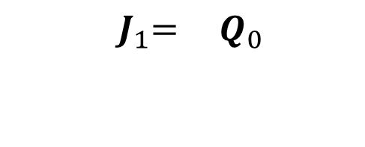
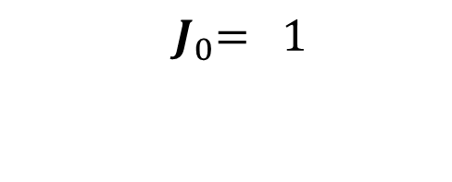
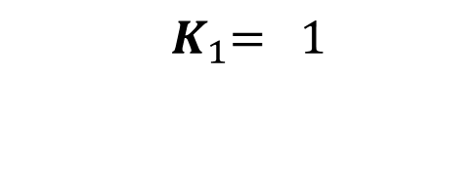
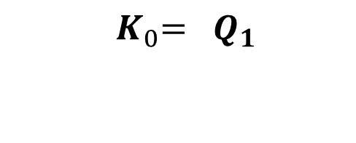
SIMPLIFICATION(K-MAP)
PRESENT STATE |  | JK FLIP FLOP INPUTS
0 | 0 | 0 | X | 1 | X
0 | 1 | 1 | X | X | 0
1 | 1 | X | 1 | X | 1
 |  | 0 | 1
 | 0 | 0 | 1
 | 1 | X | X
 |  | 0 | 1
 | 0 | 1 | X
 | 1 | X | X
 |  | 0 | 1
 | 0 | X | X
 | 1 | X | 1
 |  | 0 | 1
 | 0 | X | 0
 | 1 | X | 1

Slide 18
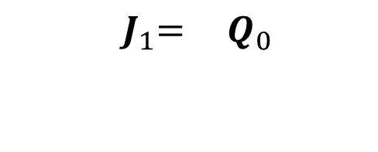
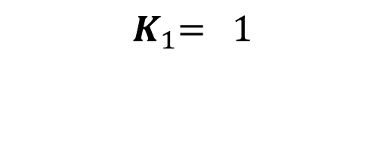
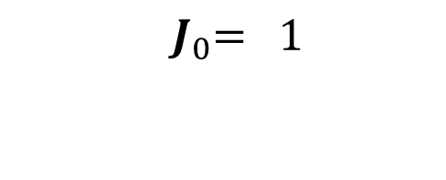
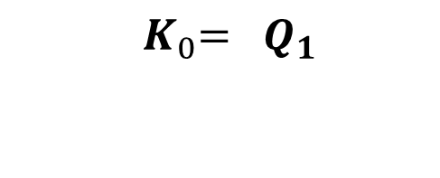
EQUATION

Slide 19
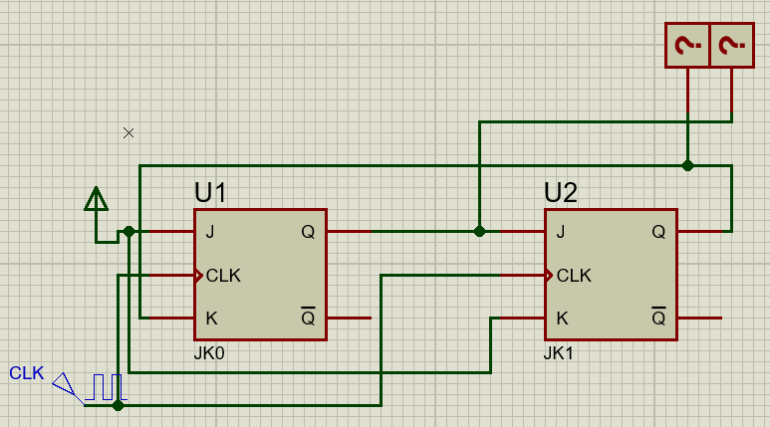
EQUATION

Slide 20

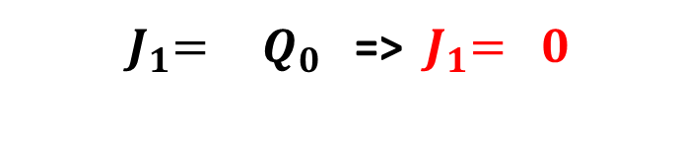
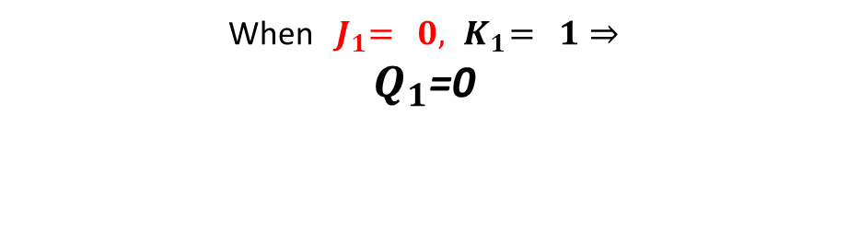
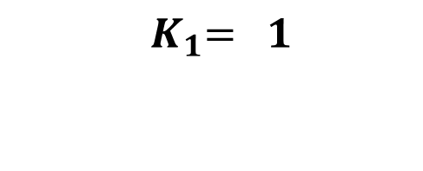
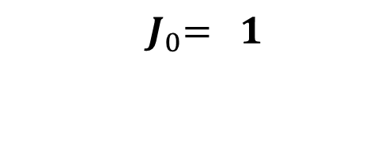
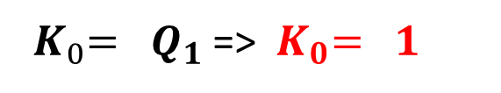

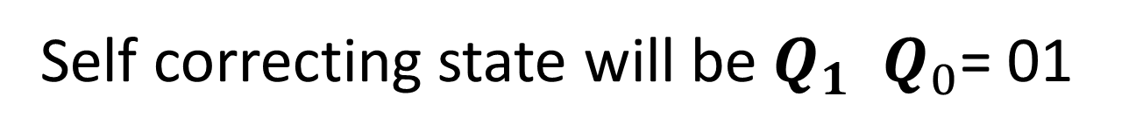
EQUATION

Slide 21
STATE DIAGRAM
UNUSED
STATE
00
10
Self Correction
01
11

Slide 22
STATE DIAGRAM
UNUSED
STATE
00
10
01
11

Slide 23
STATE DIAGRAM
UNUSED
STATE

Slide 24
NEXT STATE TABLE
PRESENT STATE |  | NEXT STATE
0 | 0 | 0 | 1
0 | 1 | 1 | 1
1 | 0 | 0 | 0
1 | 1 | 0 | 0

Slide 25
NEXT STATE TABLE USING JK FLIP FLOP
 |  | J | K
0 | 0 | 0 | X
0 | 1 | 1 | X
1 | 0 | X | 1
1 | 1 | X | 0

Slide 26
NEXT STATE TABLE
 |  | J | K
0 | 0 | 0 | X
0 | 1 | 1 | X
1 | 0 | X | 1
1 | 1 | X | 0
PRESENT STATE |  | NEXT STATE |  | JK FLIP FLOP INPUTS
0 | 0 | 0 | 1
0 | 1 | 1 | 1
1 | 0 | 0 | 0
1 | 1 | 0 | 0

Slide 27
NEXT STATE TABLE
 |  | J | K
0 | 0 | 0 | X
0 | 1 | 1 | X
1 | 0 | X | 1
1 | 1 | X | 0
PRESENT STATE |  | NEXT STATE |  | JK FLIP FLOP INPUTS
0 | 0 | 0 | 1 | 0 | X
0 | 1 | 1 | 1
1 | 0 | 0 | 0 |  |  | 0 | X
1 | 1 | 0 | 0

Slide 28
NEXT STATE TABLE
 |  | J | K
0 | 0 | 0 | X
0 | 1 | 1 | X
1 | 0 | X | 1
1 | 1 | X | 0
PRESENT STATE |  | NEXT STATE |  | JK FLIP FLOP INPUTS
0 | 0 | 0 | 1 | 0 | X | 1 | X
0 | 1 | 1 | 1 | 1 | X
1 | 0 | 0 | 0 |  |  | 0 | X
1 | 1 | 0 | 0

Slide 29
NEXT STATE TABLE
 |  | J | K
0 | 0 | 0 | X
0 | 1 | 1 | X
1 | 0 | X | 1
1 | 1 | X | 0
PRESENT STATE |  | NEXT STATE |  | JK FLIP FLOP INPUTS
0 | 0 | 0 | 1 | 0 | X | 1 | X
0 | 1 | 1 | 1 | 1 | X
1 | 0 | 0 | 0 | X | 1 | 0 | X
1 | 1 | 0 | 0 | X | 1 | X | 1

Slide 30
NEXT STATE TABLE
 |  | J | K
0 | 0 | 0 | X
0 | 1 | 1 | X
1 | 0 | X | 1
1 | 1 | X | 0
PRESENT STATE |  | NEXT STATE |  | JK FLIP FLOP INPUTS
0 | 0 | 0 | 1 | 0 | X | 1 | X
0 | 1 | 1 | 1 | 1 | X | X | 0
1 | 0 | 0 | 0 | X | 1 | 0 | X
1 | 1 | 0 | 0 | X | 1 | X | 1

Slide 31
NEXT STATE TABLE
 |  | J | K
0 | 0 | 0 | X
0 | 1 | 1 | X
1 | 0 | X | 1
1 | 1 | X | 0
PRESENT STATE |  | NEXT STATE |  | JK FLIP FLOP INPUTS
0 | 0 | 0 | 1 | 0 | X | 1 | X
0 | 1 | 1 | 1 | 1 | X | X | 0
1 | 0 | 0 | 0 | X | 1 | 0 | X
1 | 1 | 0 | 0 | X | 1 | X | 1

Slide 32
NEXT STATE TABLE
 |  | J | K
0 | 0 | 0 | X
0 | 1 | 1 | X
1 | 0 | X | 1
1 | 1 | X | 0
PRESENT STATE |  | JK FLIP FLOP INPUTS
0 | 0 | 0 | X | 1 | X
0 | 1 | 1 | X | X | 0
1 | 0 | X | 1 | 0 | X
1 | 1 | X | 1 | X | 1

Slide 33

SIMPLIFICATION(K-MAP)
PRESENT STATE |  | JK FLIP FLOP INPUTS
0 | 0 | 0 | X | 1 | X
0 | 1 | 1 | X | X | 0
1 | 0 | X | 1 | 0 | X
1 | 1 | X | 1 | X | 1
 |  | 0 | 1
 | 0 | 0 | 1
 | 1 | X | X
 |  | 0 | 1
 | 0 | 1 | X
 | 1 | 0 | X
 |  | 0 | 1
 | 0 | X | X
 | 1 | 1 | 1
 |  | 0 | 1
 | 0 | X | 0
 | 1 | X | 1

Slide 34
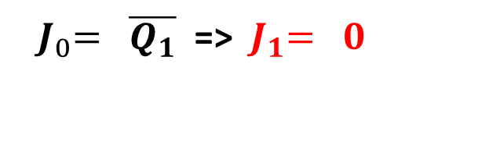

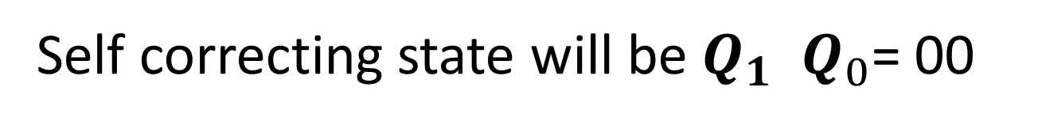
EQUATION

Slide 35
STATE DIAGRAM
UNUSED
STATE
00
10
01
11

Slide 36
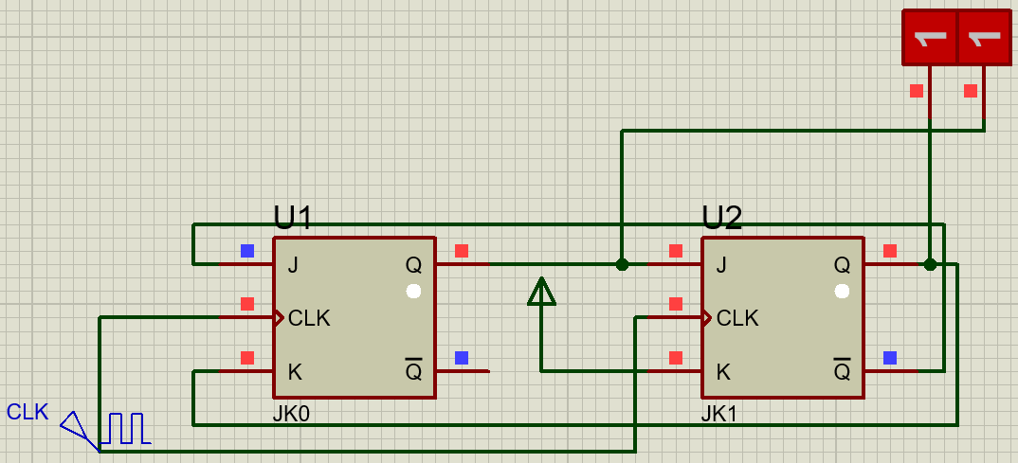
PROTEUS SIMULATION

